Slide 1


BARD Coordinate Analysis
Coded and Compiled
by Andrew Iraola

Slide 2
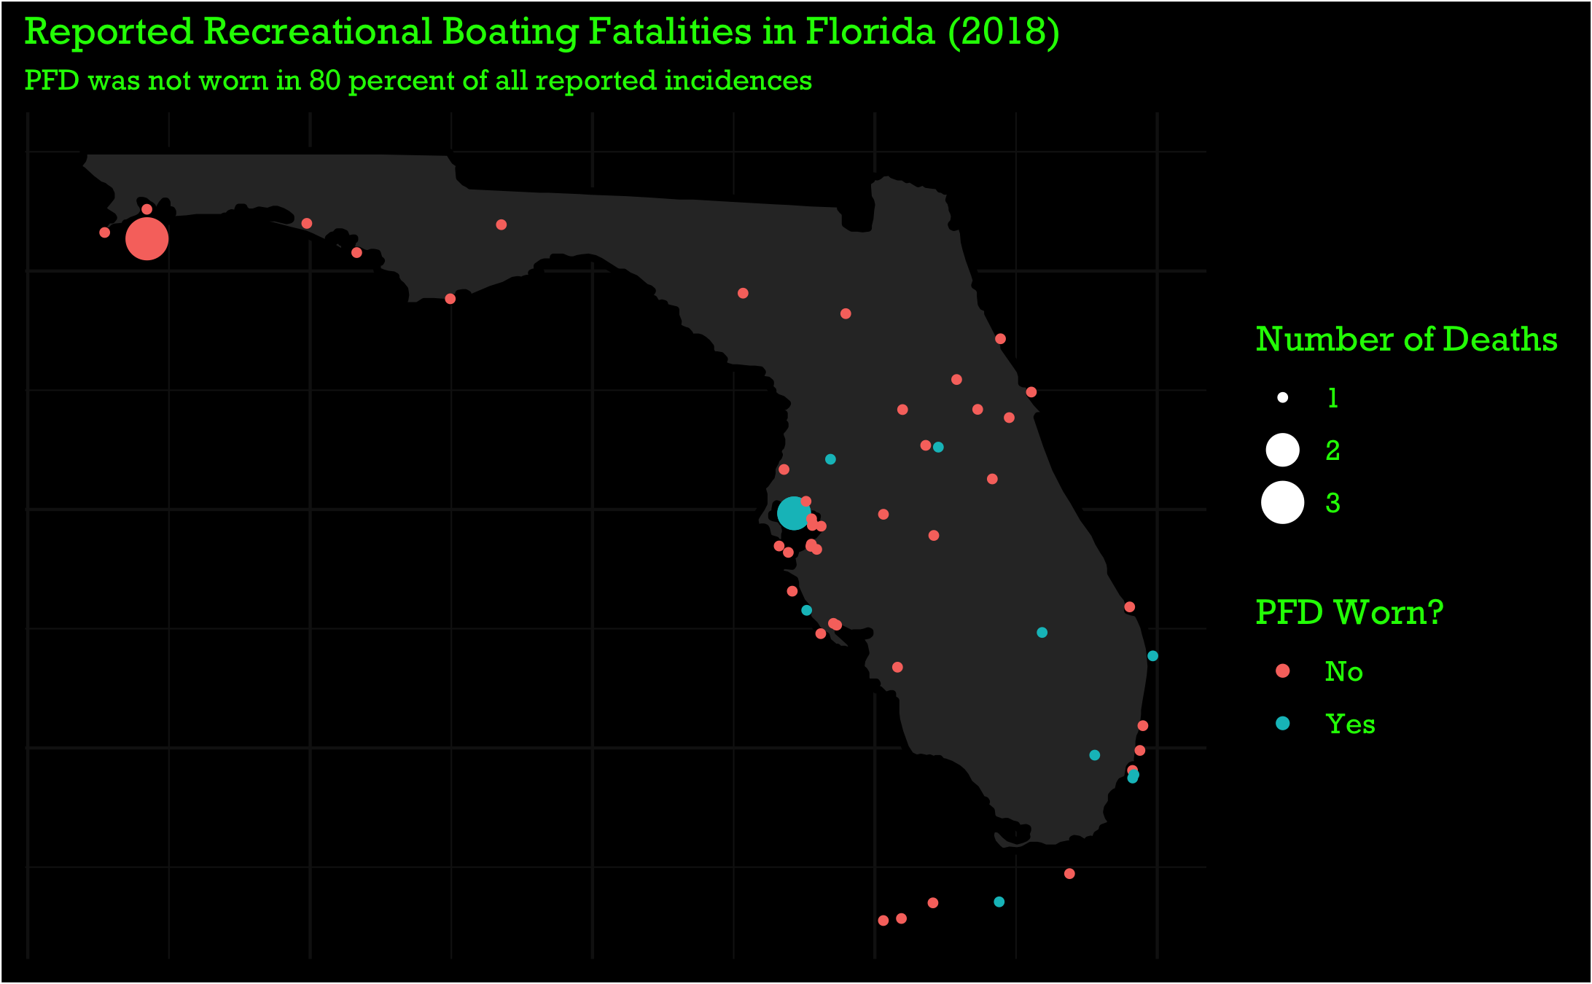

Slide 3
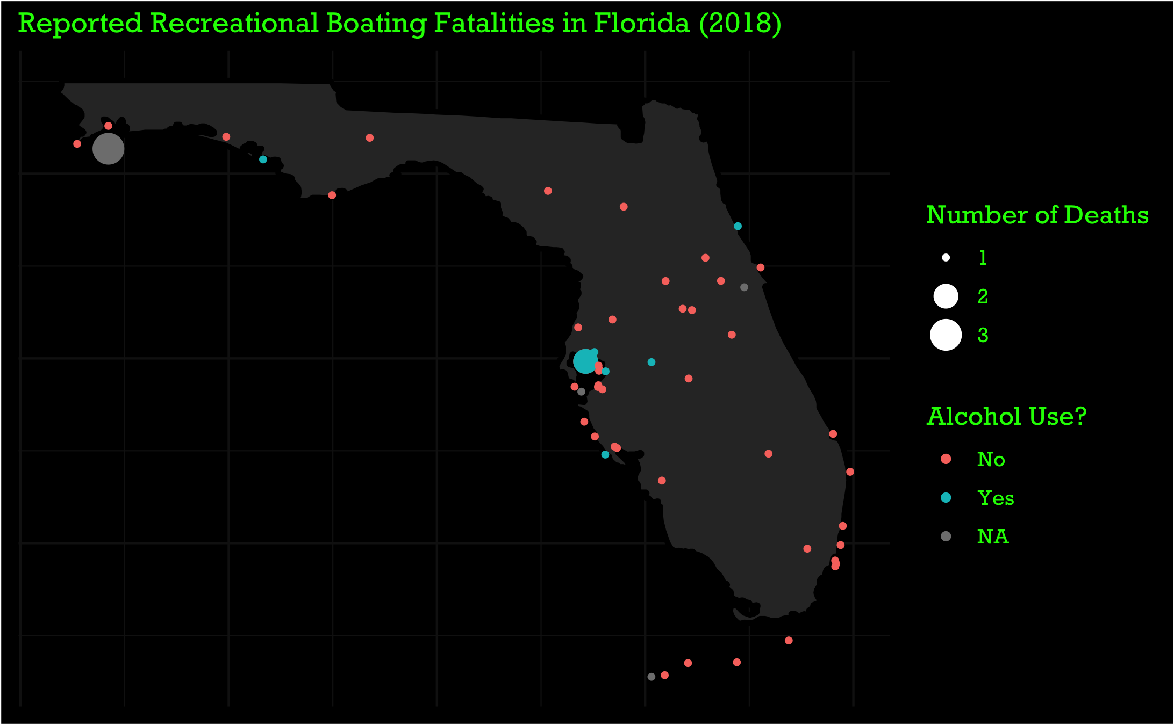

Slide 4
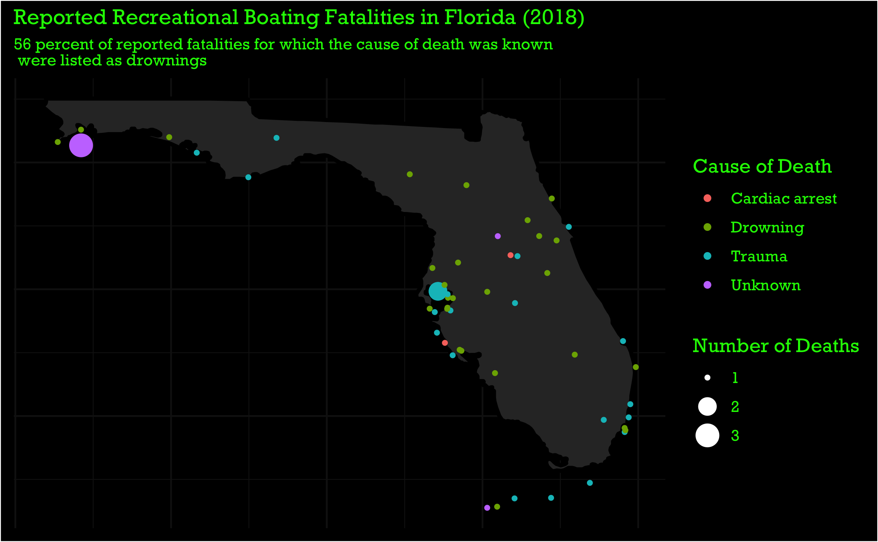

Slide 5
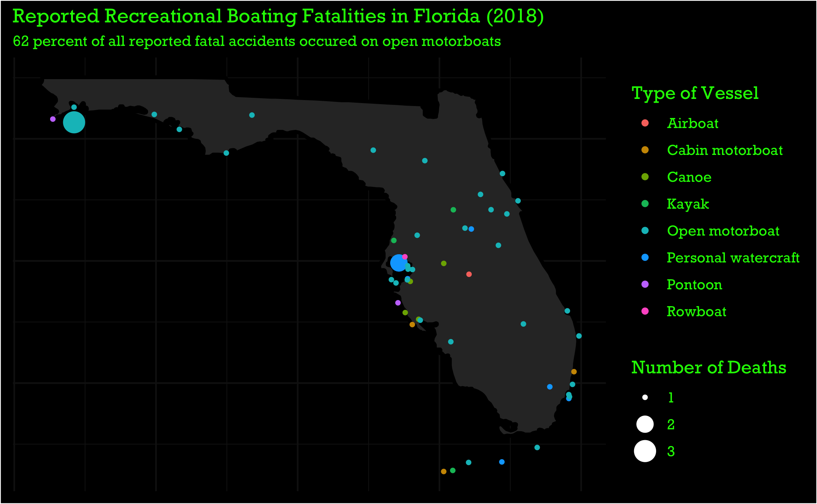

Slide 6
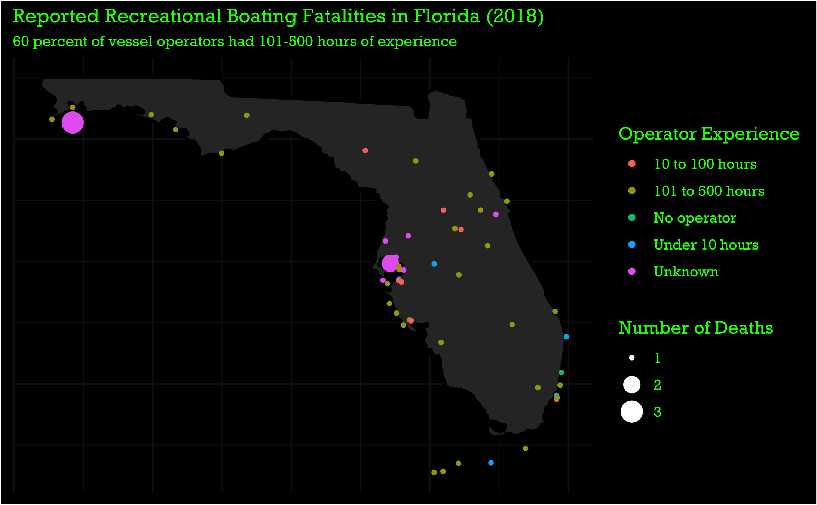

Slide 7
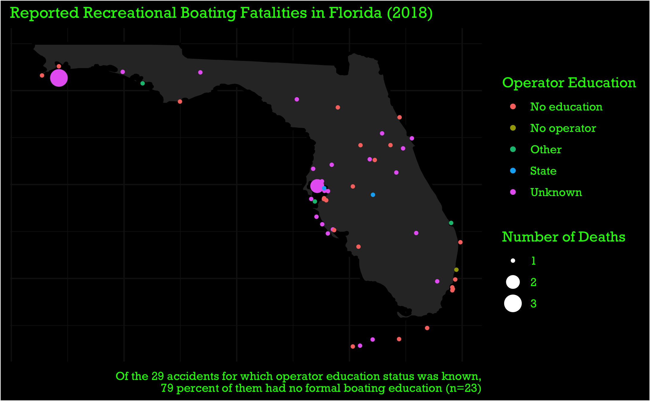

Slide 8
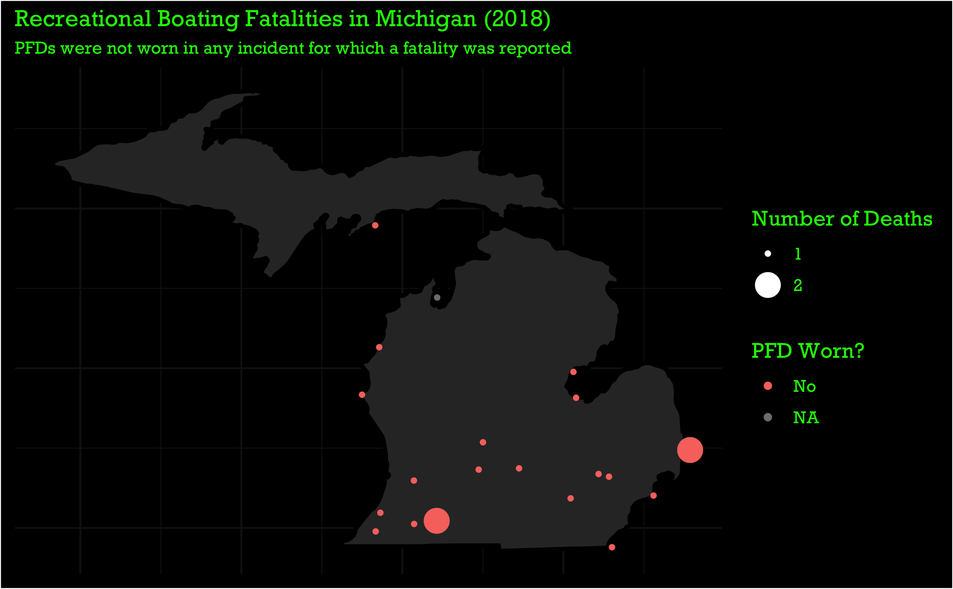

Slide 9
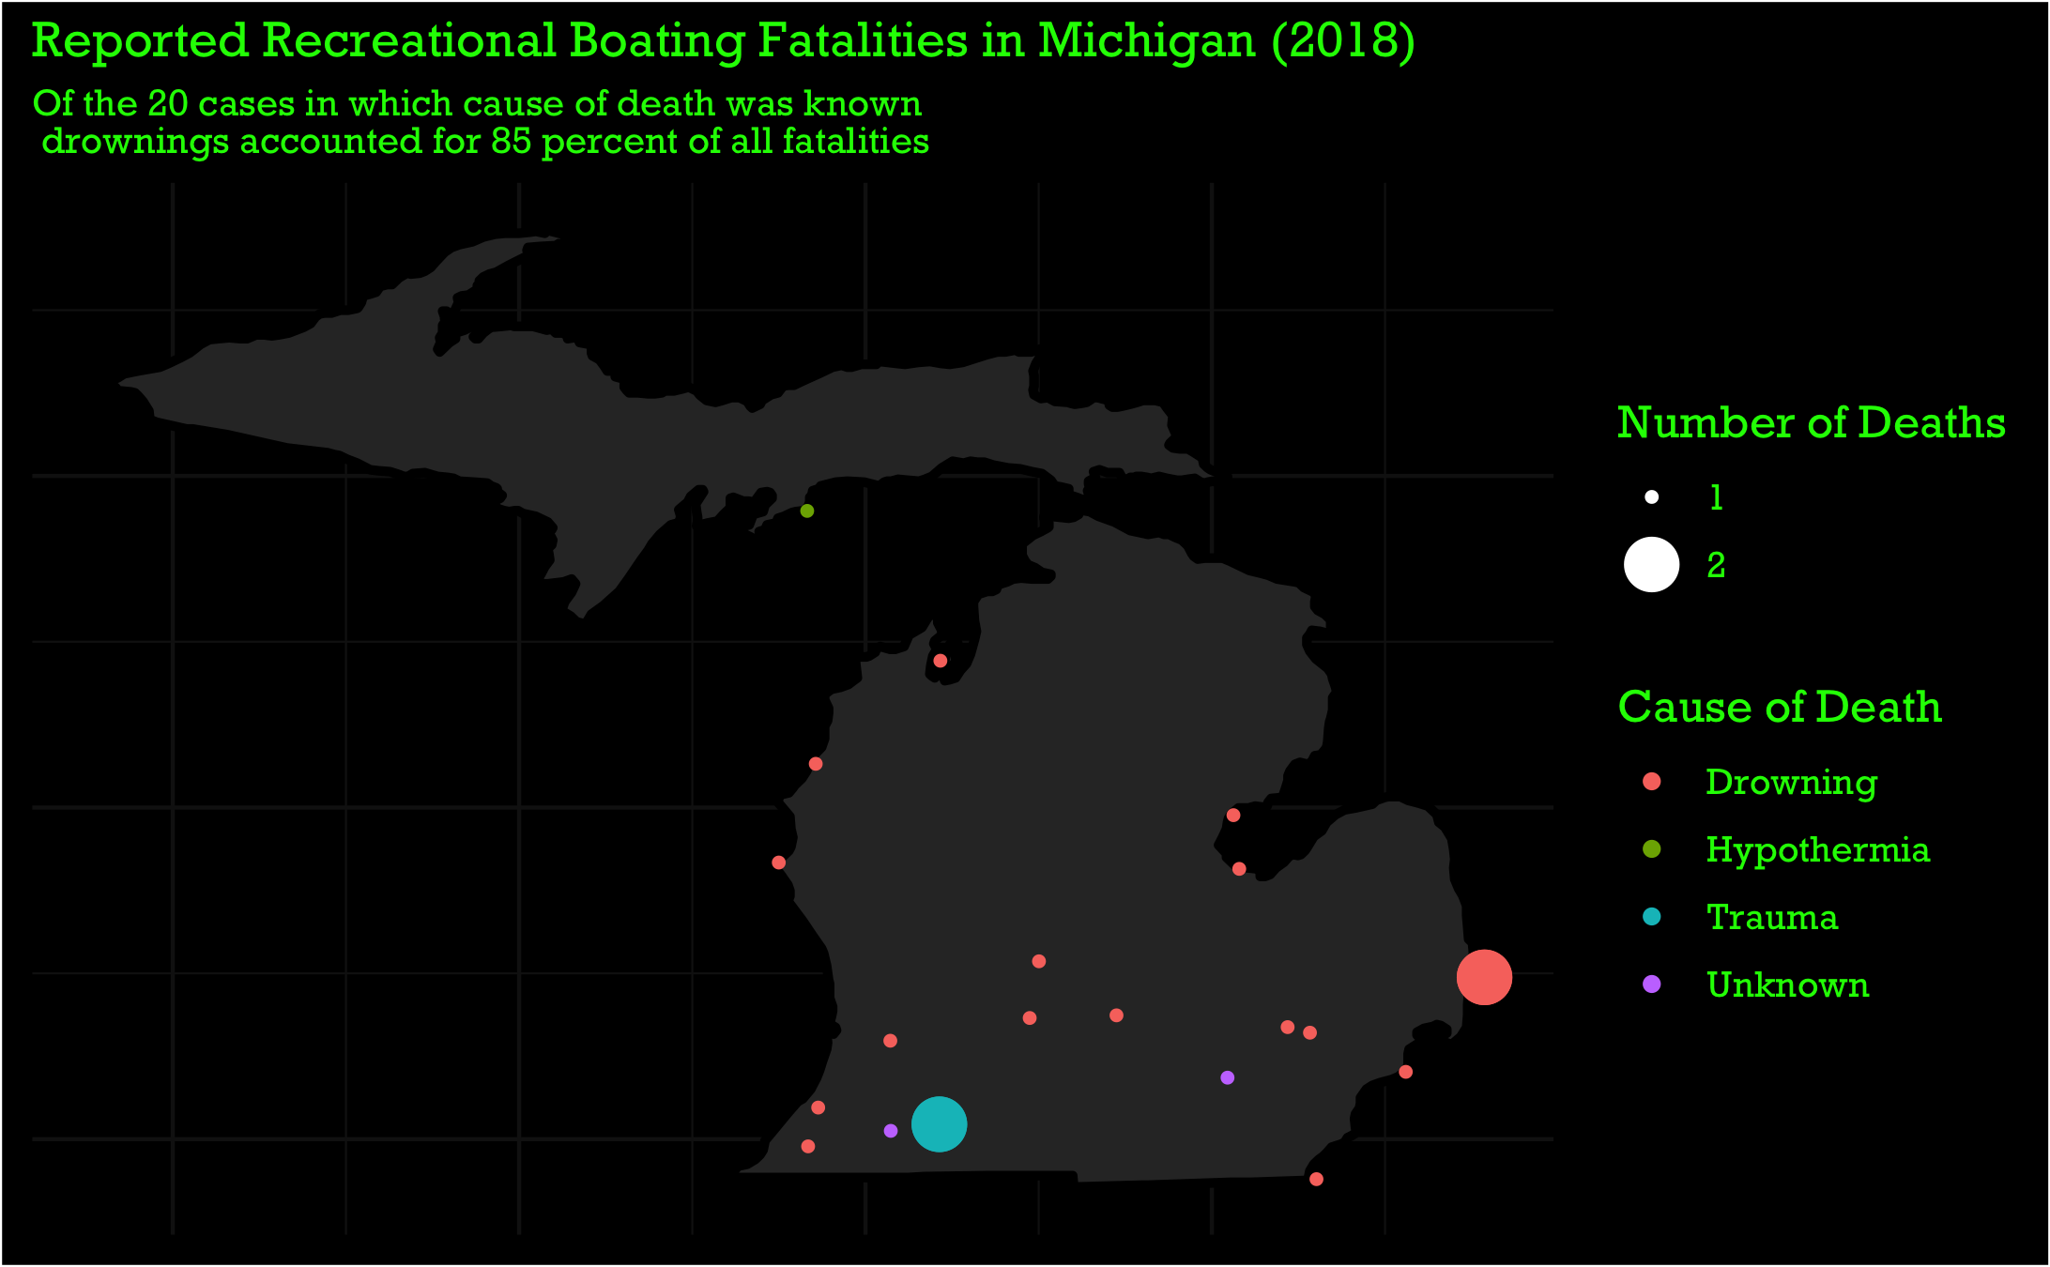

Slide 10
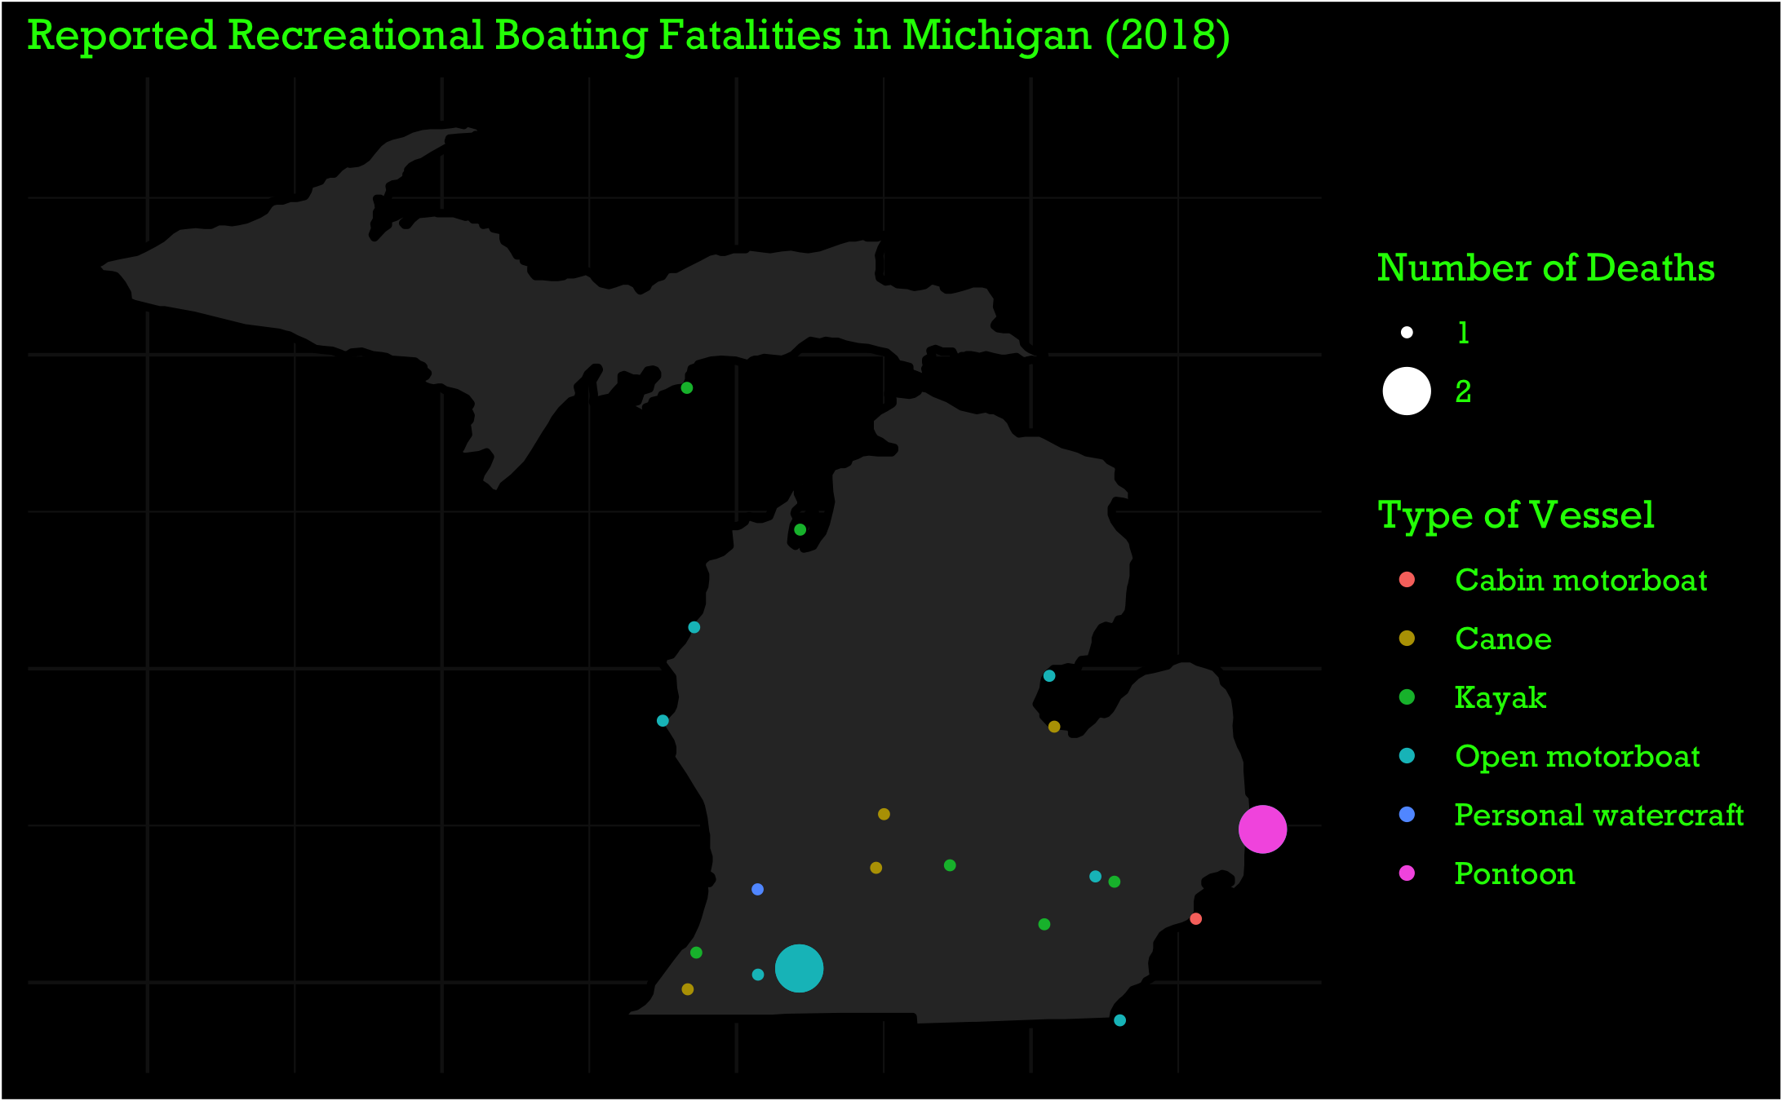

Slide 11
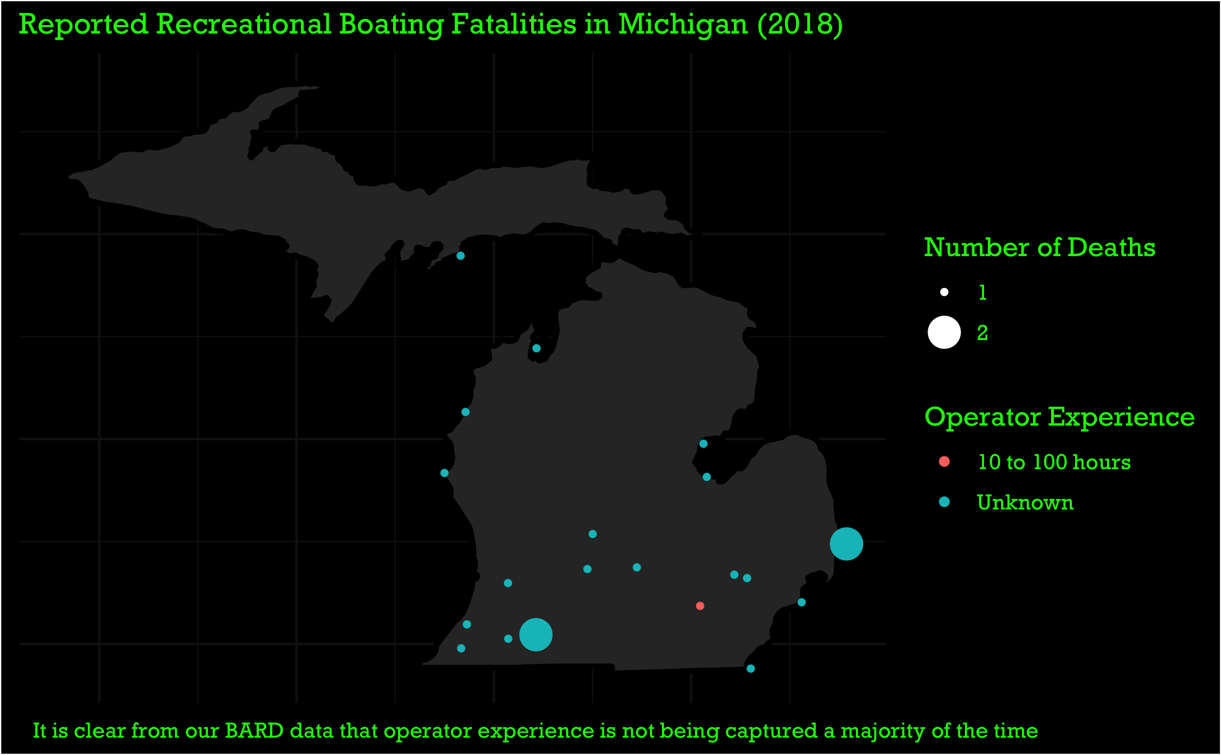
Notes:
This might be something we would want to share with the state of Michigan (or any other state in which this data is lacking).
Sometimes, awareness alone will encourage people to try harder. If they don’t realize they aren’t collecting something, why would they ever try?

Slide 12
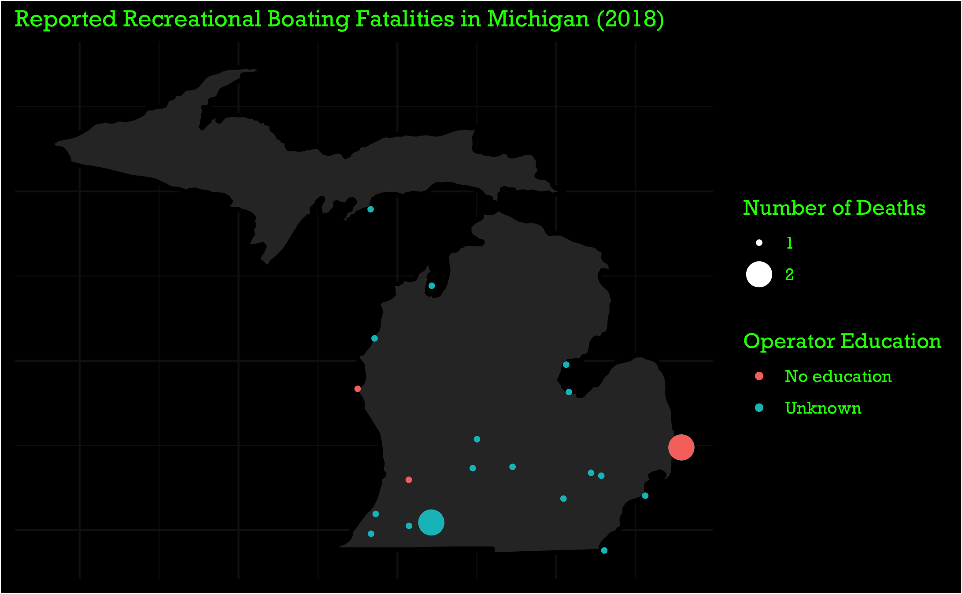
Notes:
The same thing applies for education…

Slide 13
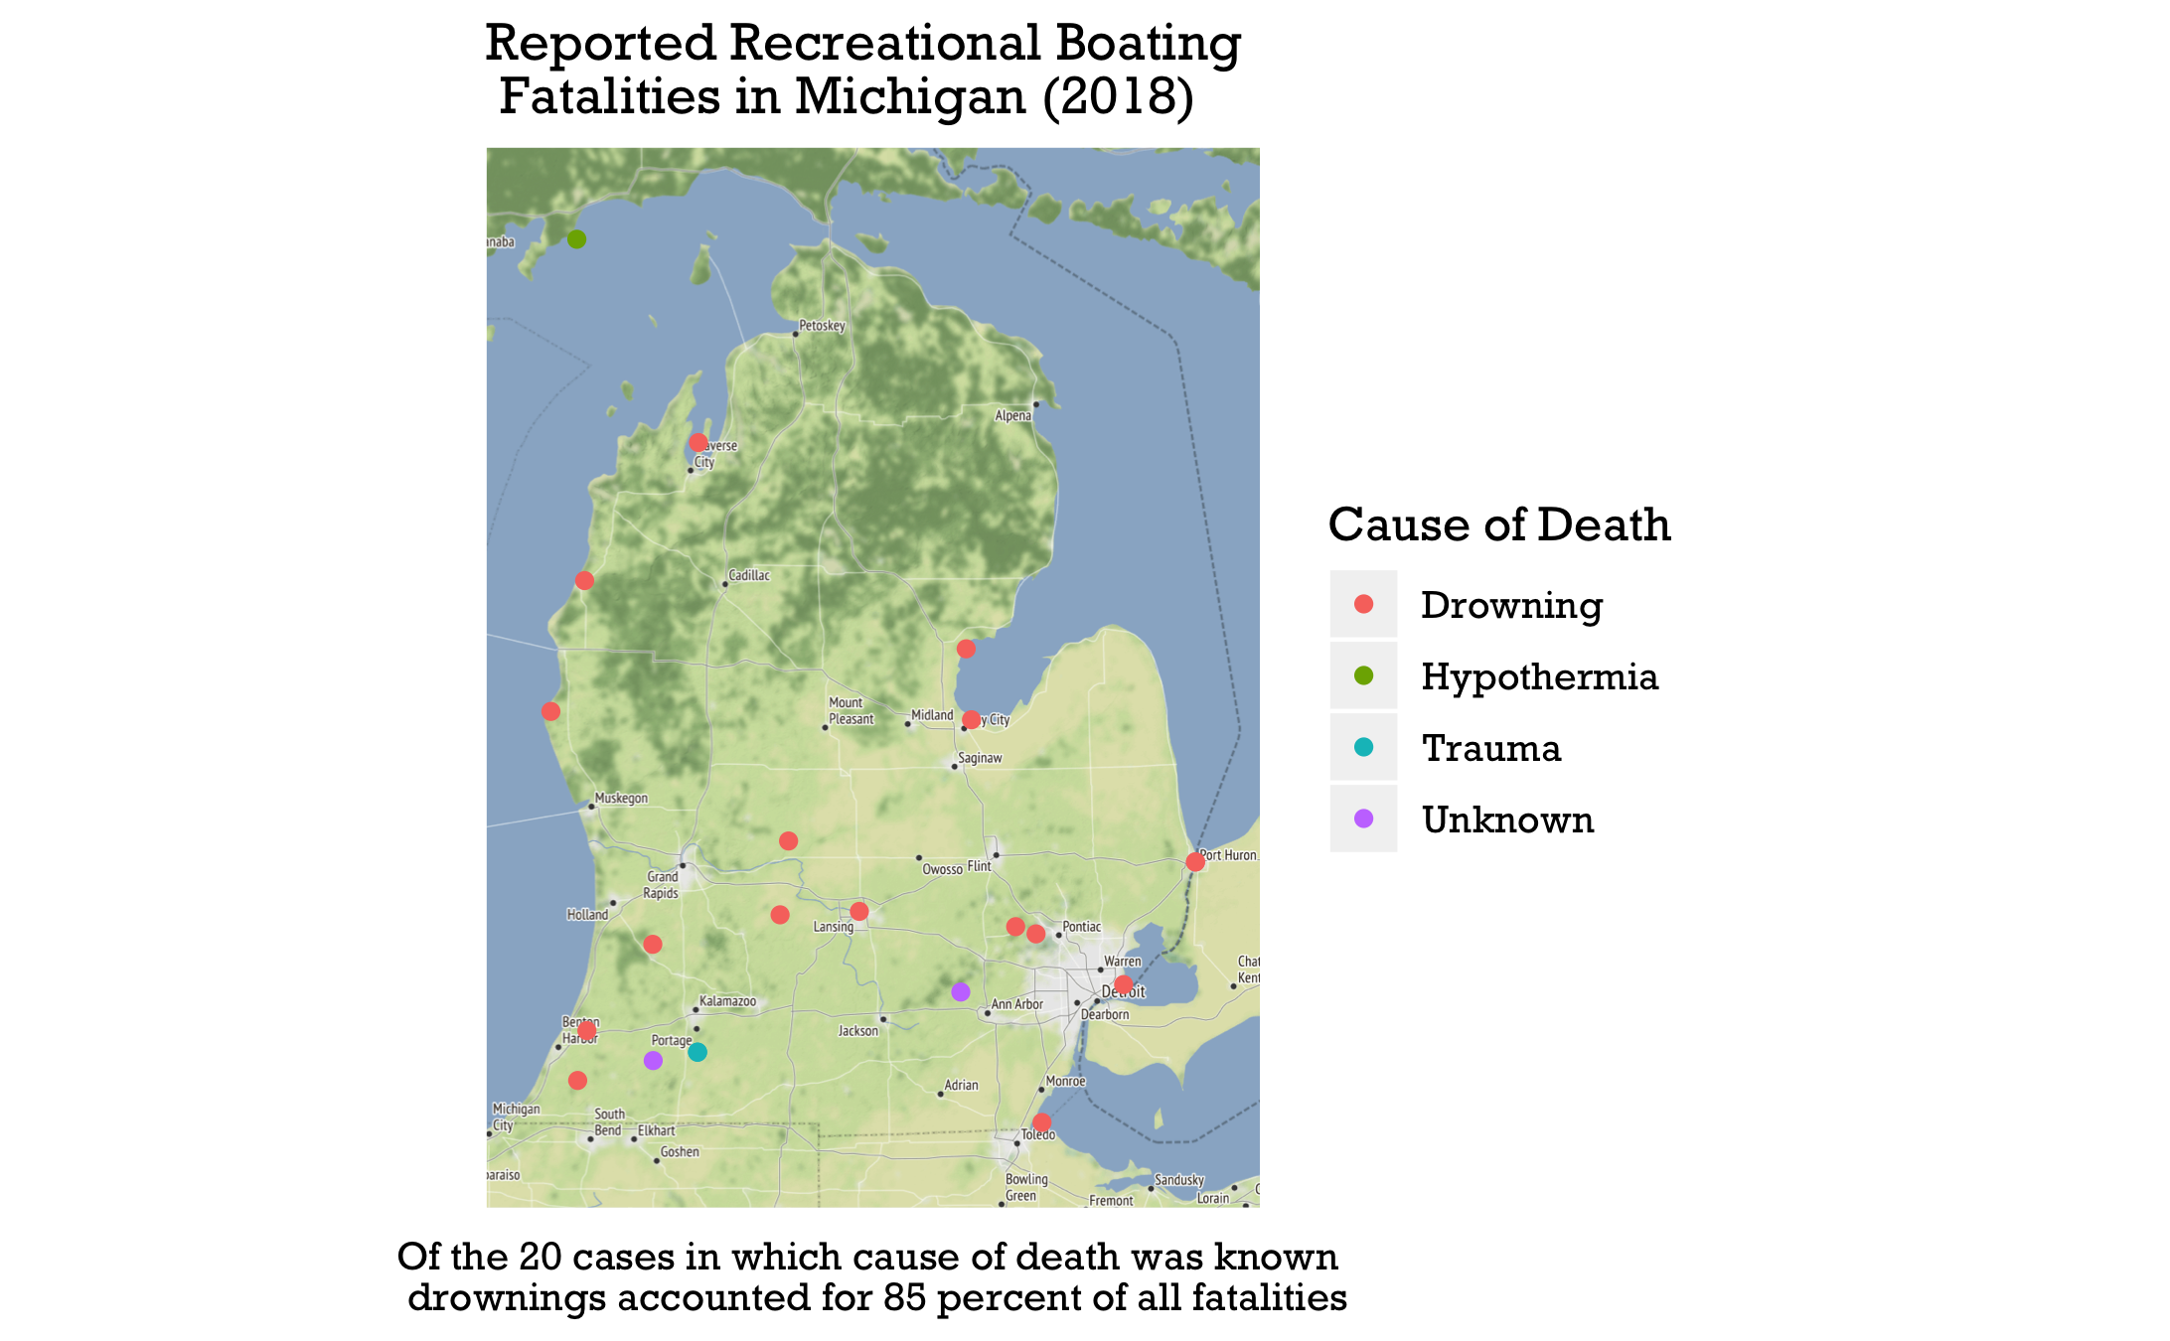

Slide 14
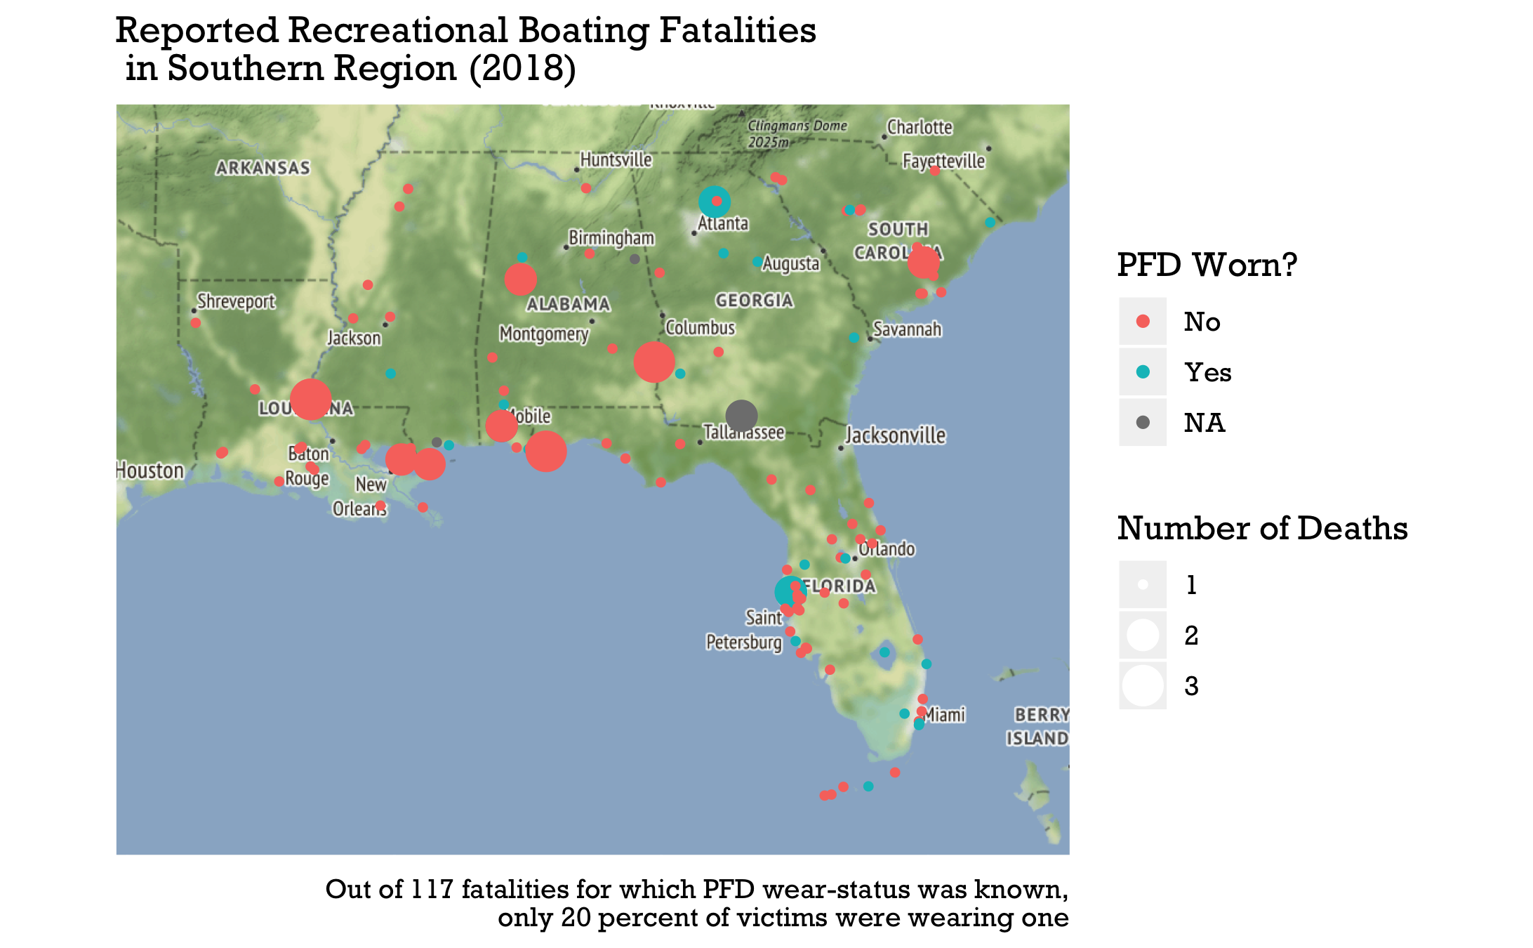

Slide 15
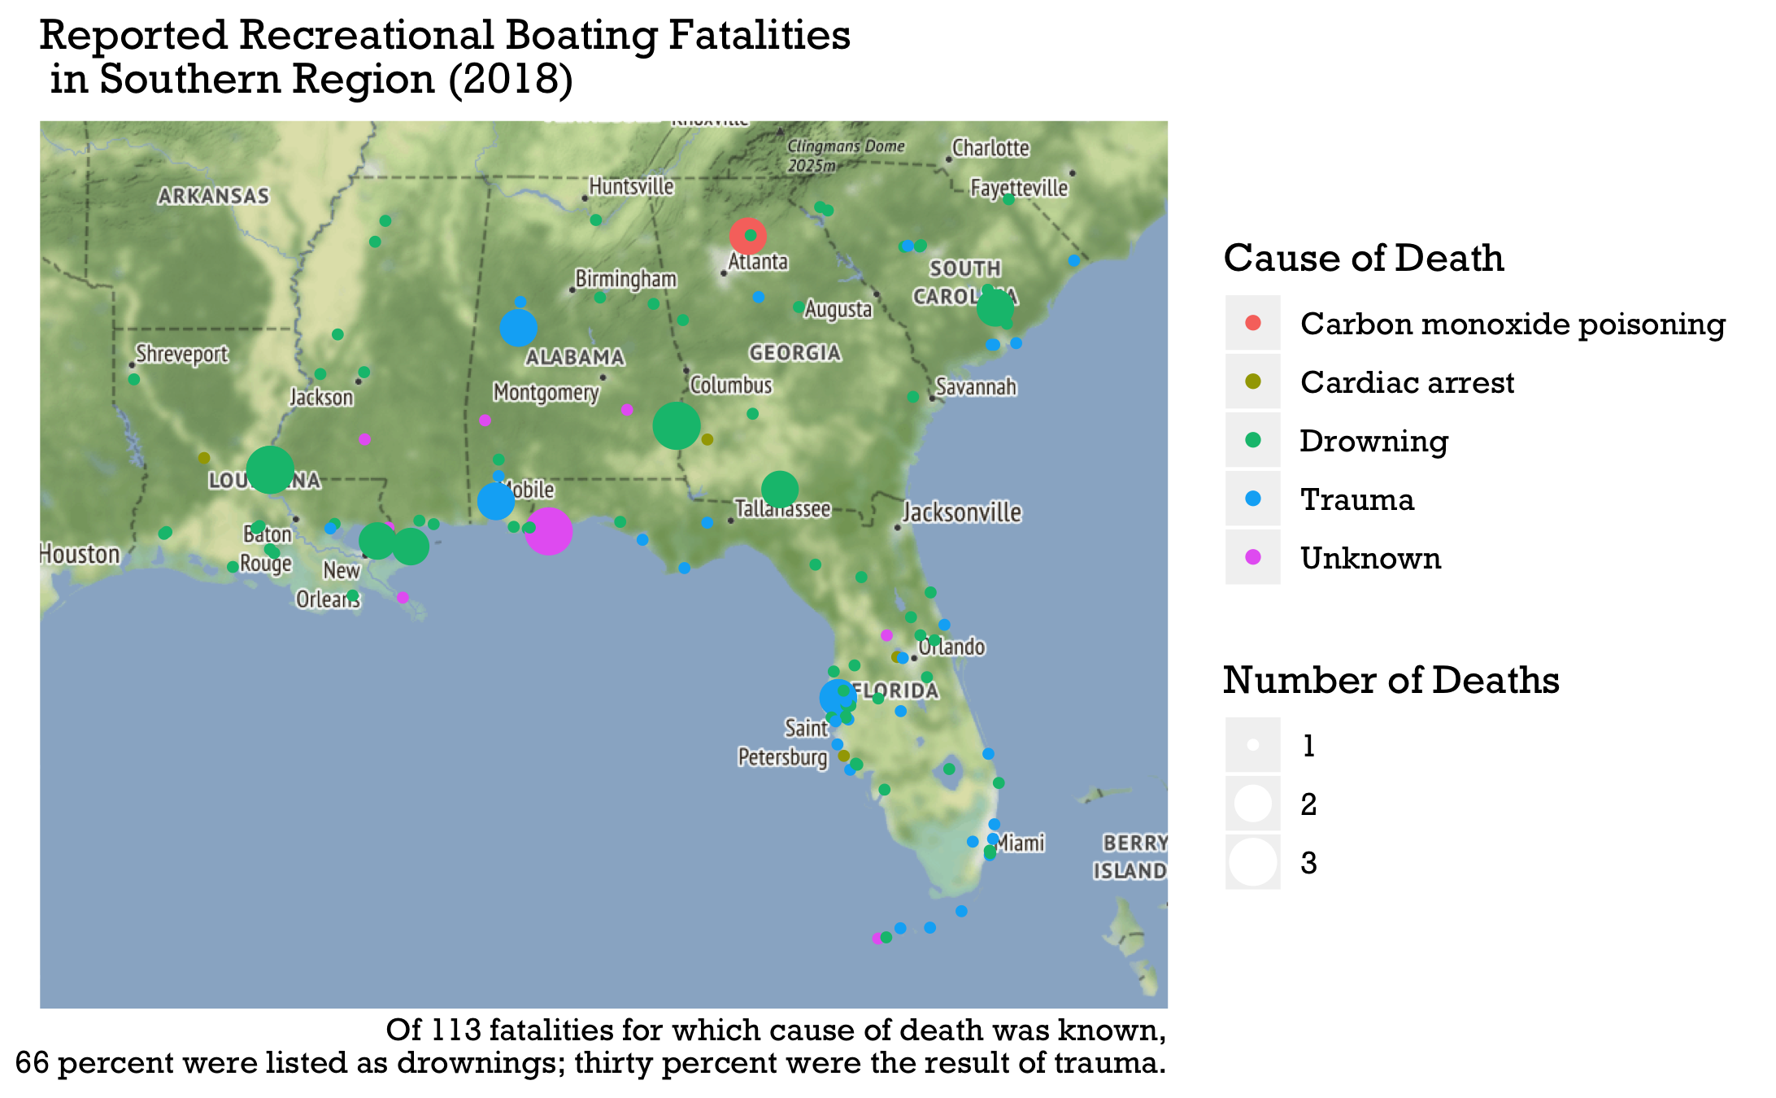

Slide 16
BARD Text Analysis Results

Slide 17
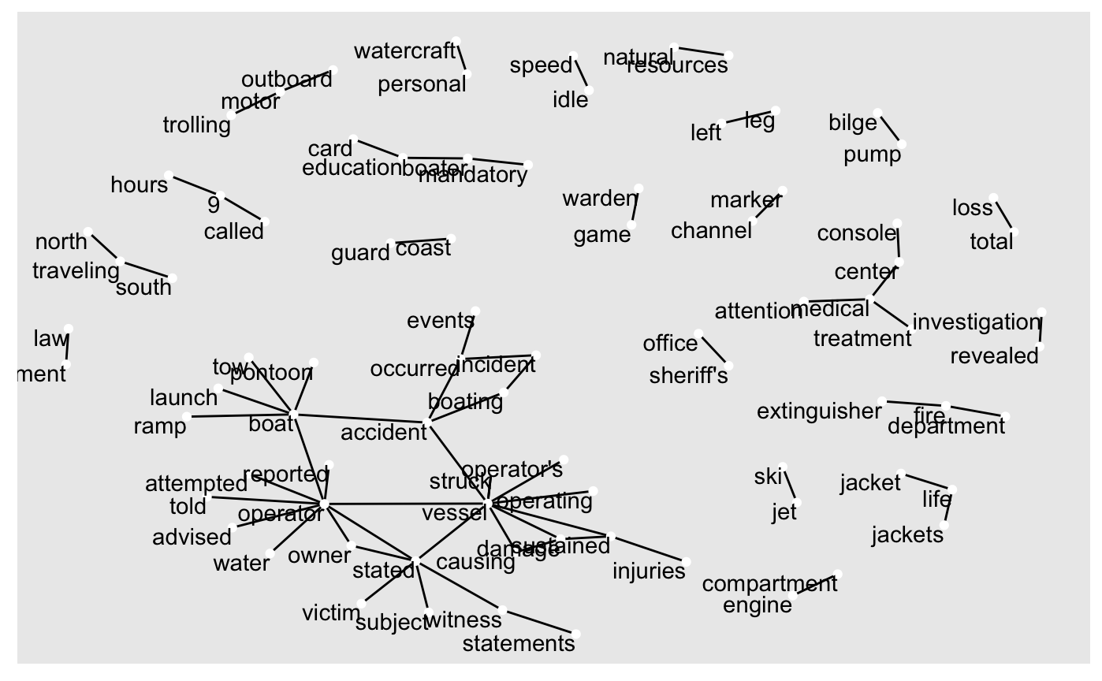

Slide 18
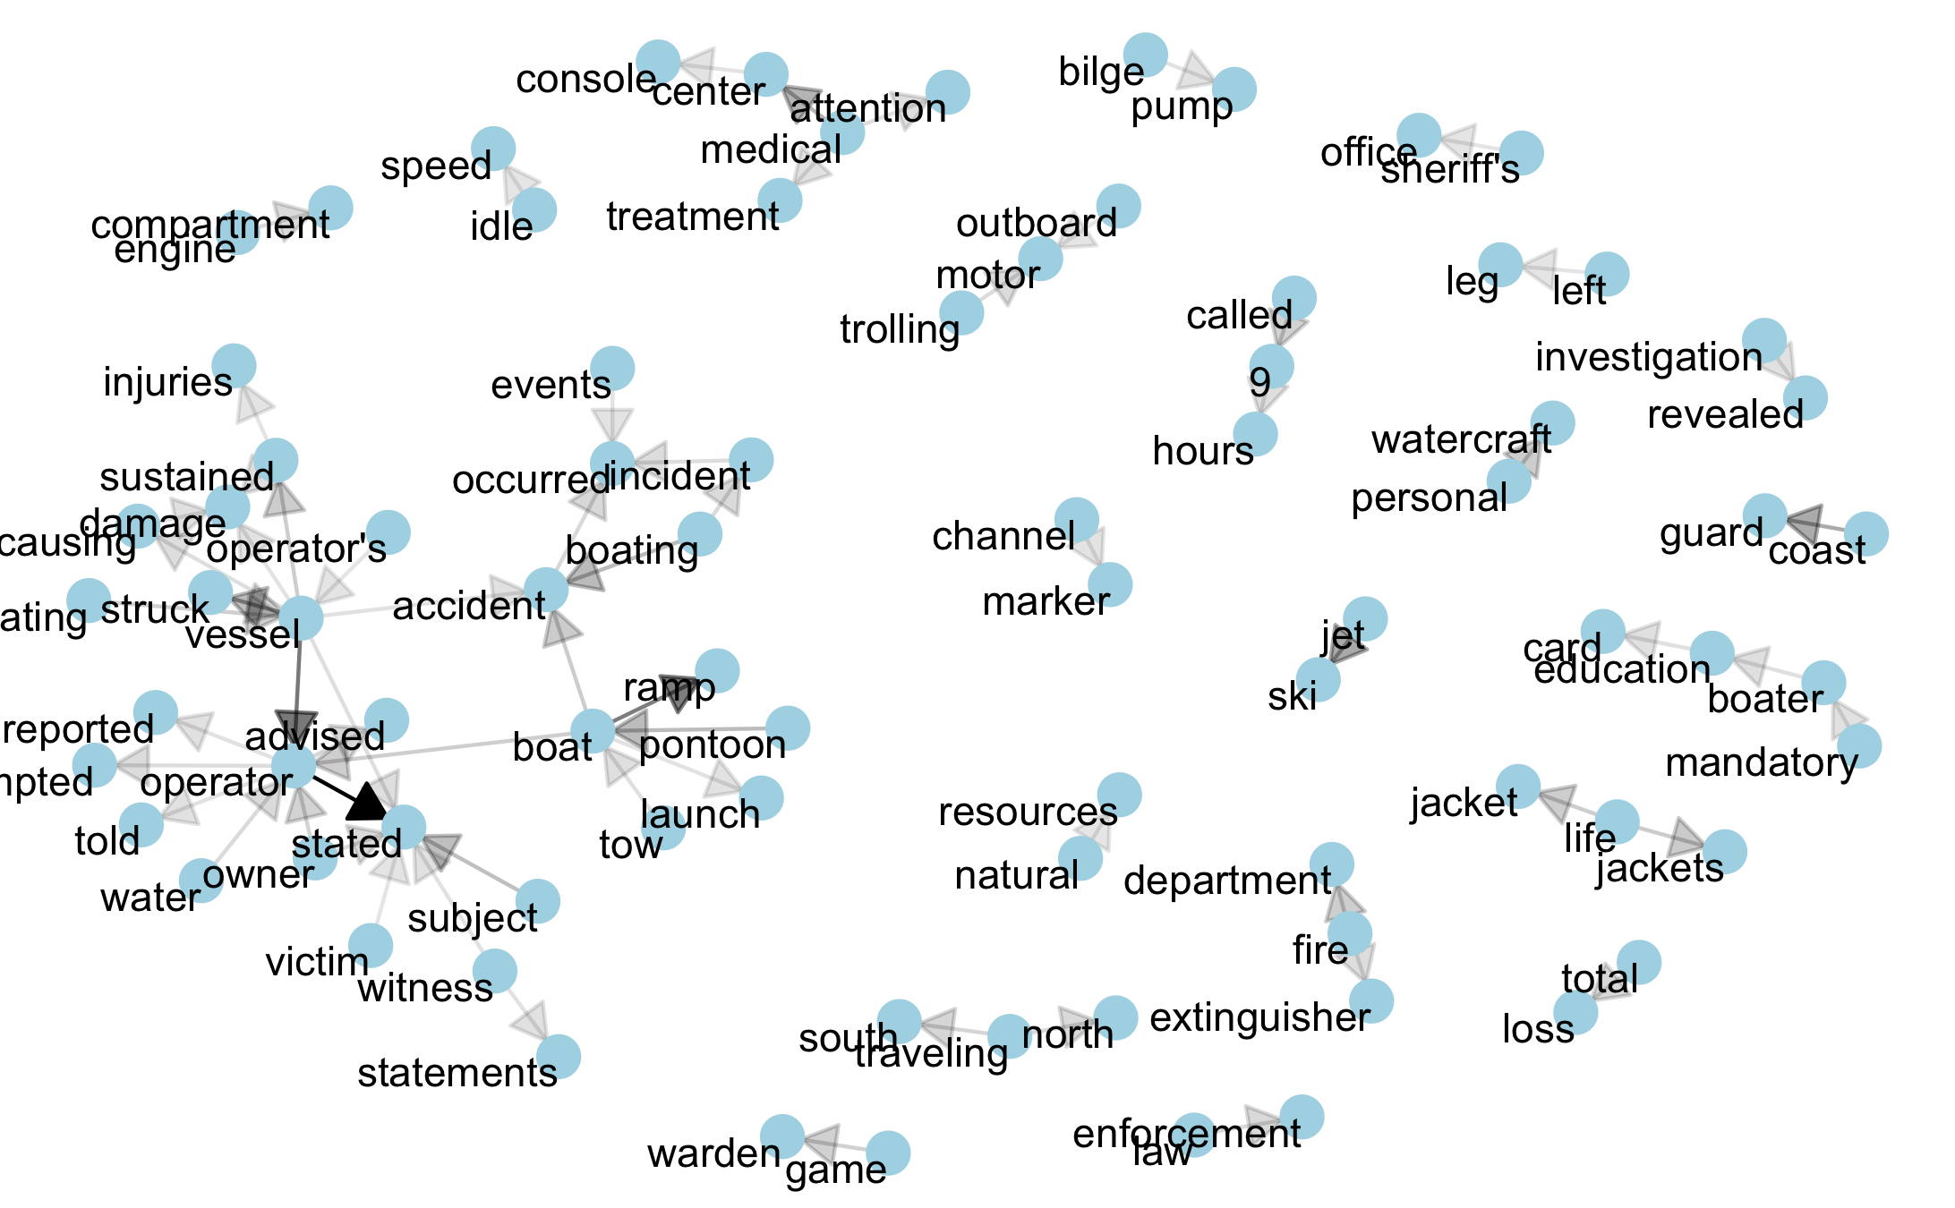

Slide 19
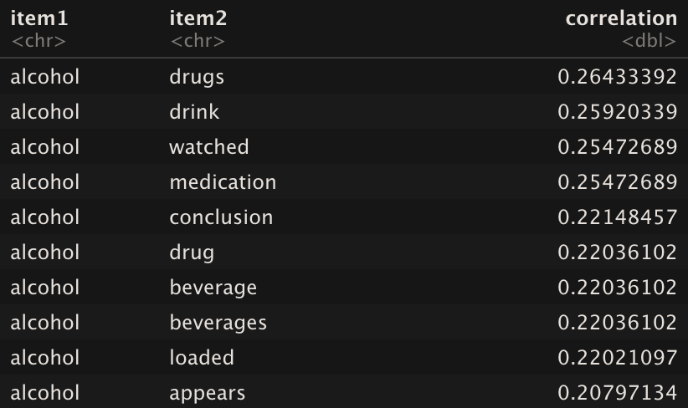
Correlates With the Word, “alcohol”
Notes:
Note that we can apply this to any word we want: “kayak”, “canoe”, “pfd”, ”kill switch”

Slide 20
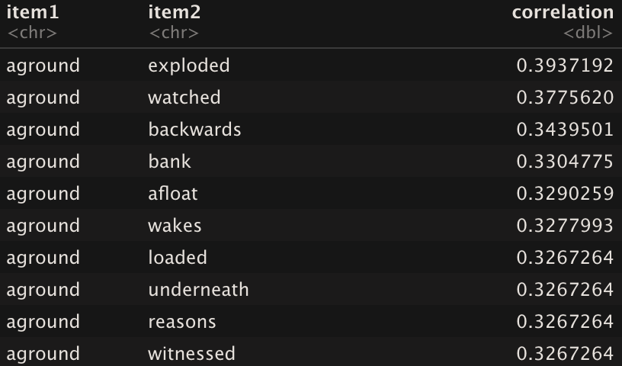
Correlates With the Word, “aground”
Notes:
Also saw the word, ‘unconscious’ at a 30% correlation. Implies that if you have the word ‘aground’ in 100 different reports, it will be in almost 40 of them.

Slide 21
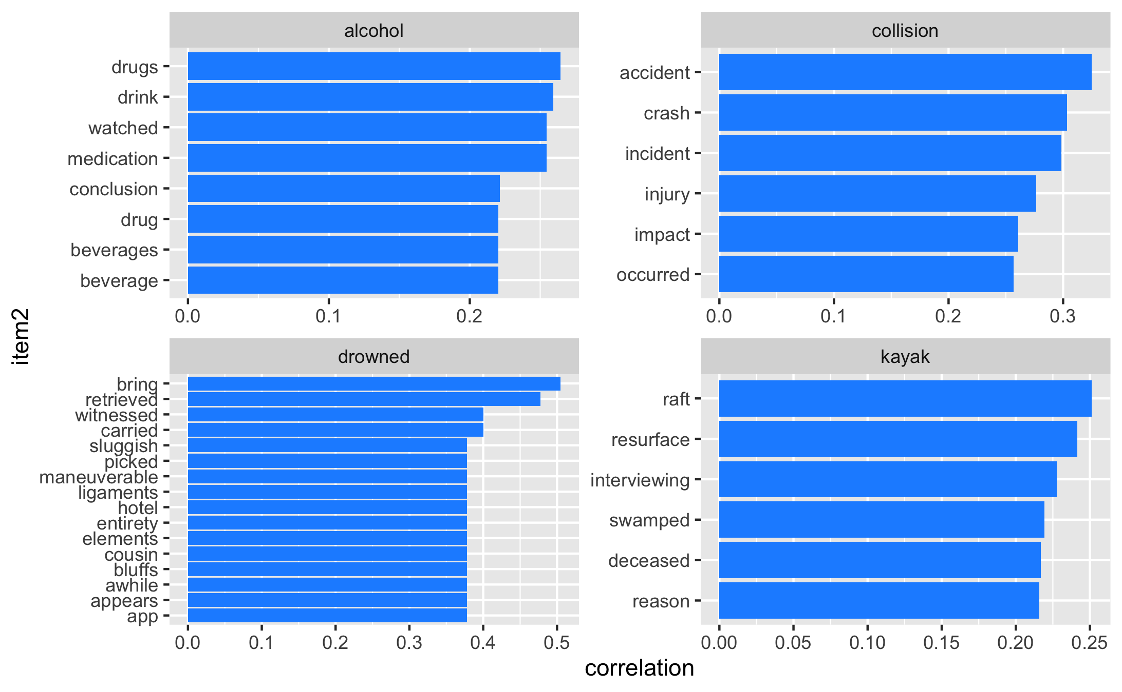

Slide 22
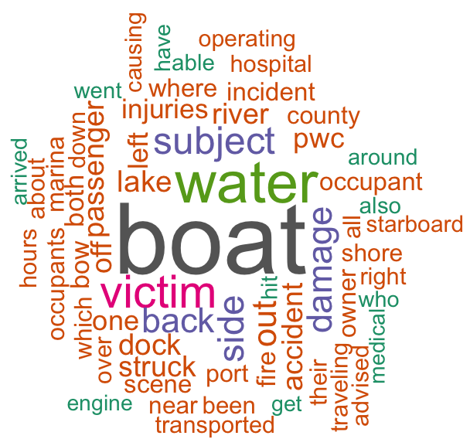
Word Cloud of Most Common Words

